Slide 1






Lab 1
Group Pi

Slide 2
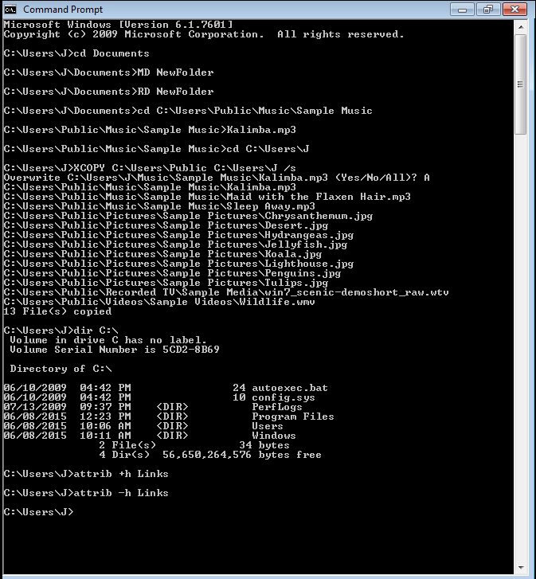
Command Prompt
Use “CD” to navigate to a folder
Use “MD” to create a new folder
Use “RD” to remove a folder
To open a file: cd to the folder the file is in, then type the filename followed by its extension
Use “XCOPY” to copy and paste folder by first navigating to the directory you want to move the folders to, then use “XCOPY” followed by the the directory you want copy then the destination and finally “/s” to make sure you copy all subfolders as well
Use “DIR” to list a directory
Use “ATTRIB +H” to hide a folder
Use “ATTRIB -H” to unhide the folder

Slide 3
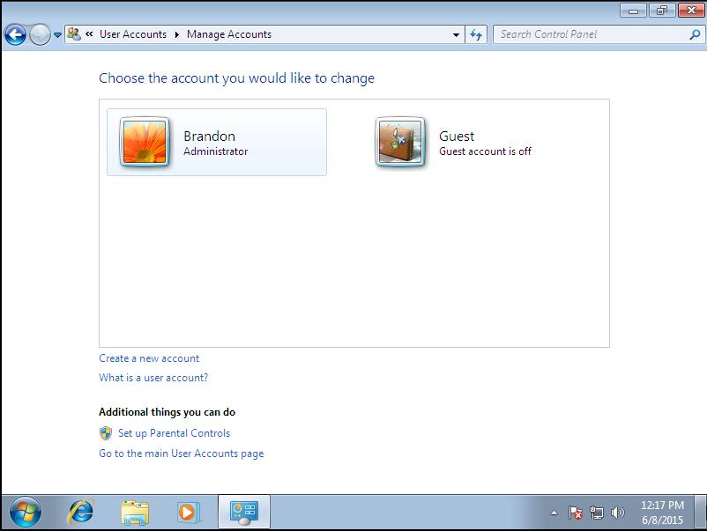
Adding New User In Control Panel
Open Control Panel
Under ‘User Account and Family Safety’ select ‘add or remove user account’
Create a new account
Name account and select type

Slide 4
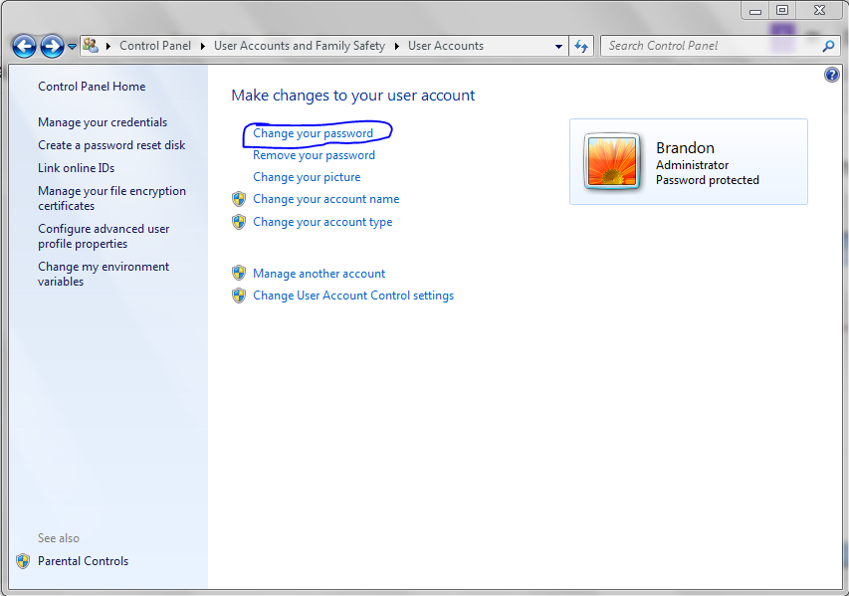
Changing Password In Control Panel
Open Control Panel
Under ‘User Account and Family Safety’ select ‘change your windows password’.
Click ‘Change your password’.
Type in new and old password.

Slide 5
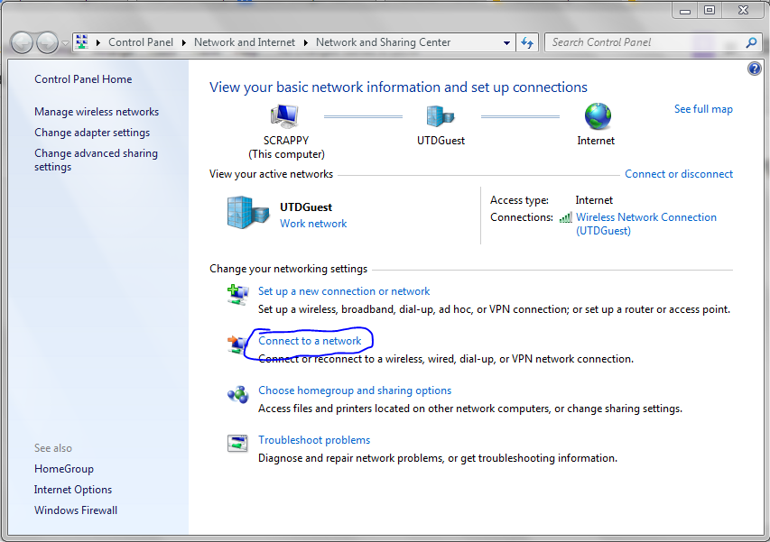
Connect to a network using the Network and Sharing Center
Open Networking and Sharing Center
Select ‘Connect to a network’
Select Network

Slide 6
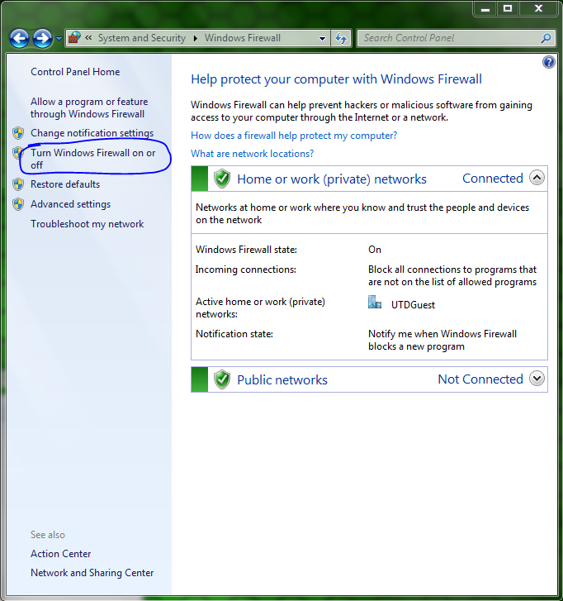
Enable Windows Firewall
Open Control Panel
Select Windows Firewall
In the left hand column click ‘Turn Windows Firewall on or off’
Check ‘Turn on Windows Firewall’

Slide 7
Enable Windows Firewall
Open Control Panel
Select Windows Firewall
In the left hand column click ‘Turn Windows Firewall on or off’
Check ‘Turn on Windows Firewall’

Slide 8
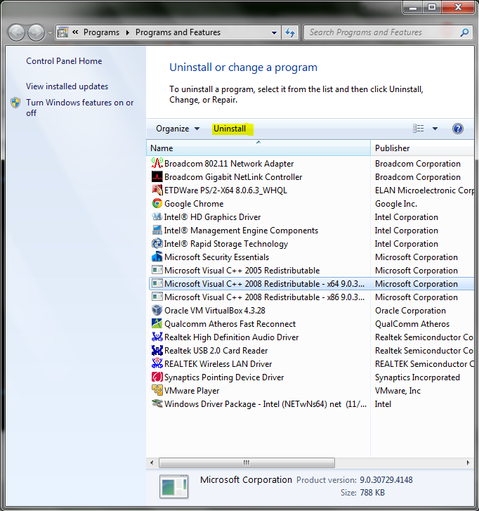
Remove Unwanted Programs
Type uninstall in start menu
open ‘Uninstall a program’
Click on the program then click the ‘Uninstall button’

Slide 9
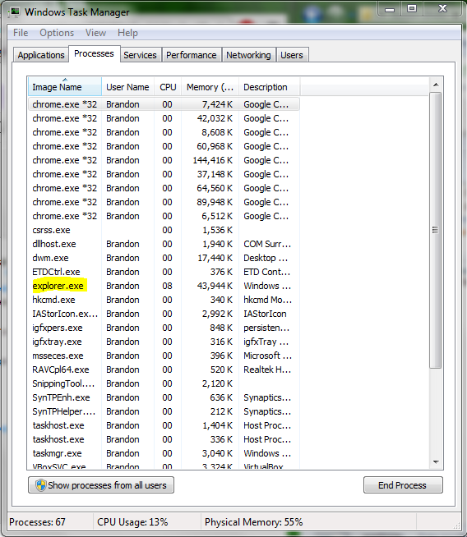
Restart explorer.exe in Task Manager
Press ctrl+alt+del.
Switch to the ‘processes’ tab
Right click explorer.exe and click restart

Slide 10
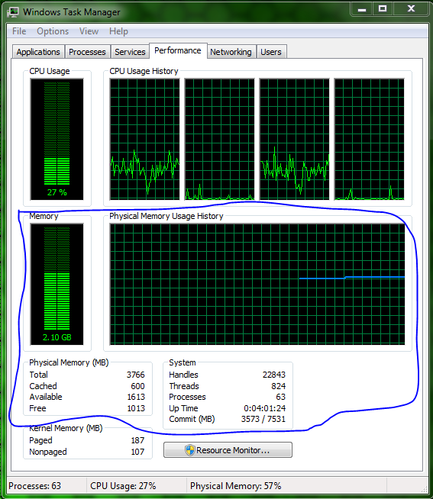
View your RAM usage in Task Manager
Press ctrl+alt+del.
Switch to the ‘Performance’ tab
View RAM usage

Slide 11
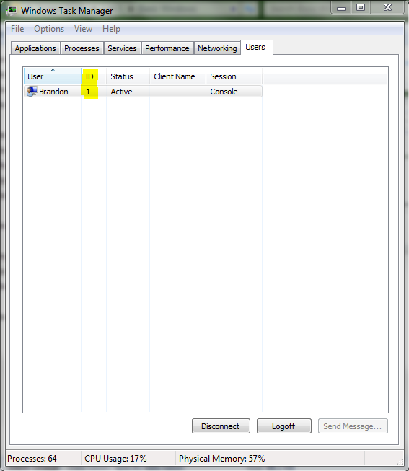
Find out your User ID in Task Manager
Press ctrl+alt+del.
Switch to the ‘Users’ tab
Look at number in ID column

Slide 12
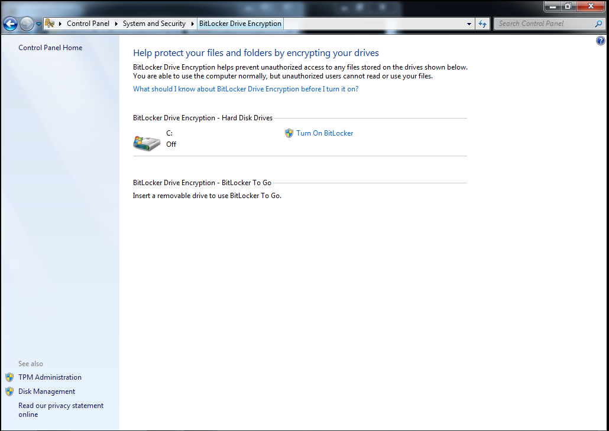
Turn on Bitlocker Encryption
Press ctrl+alt+del.
Switch to the ‘Users’ tab
Look at number in ID column

Slide 13
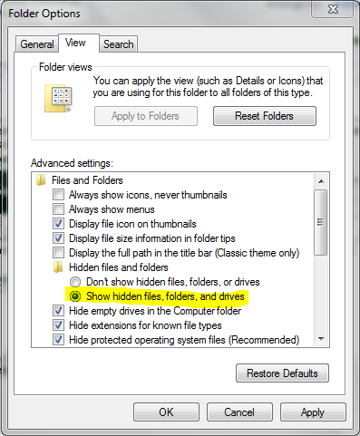
Turn on hidden files
Open folder options in start menu.
Navigate to ‘View Tab’
Under Hidden File and Folders select the ‘Show hidden files, folders, and drives’

Slide 14
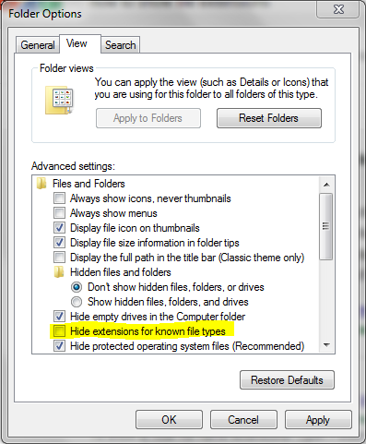
Show File Extensions
Open folder options in start menu.
Navigate to ‘View Tab’
Uncheck ‘Hide extensions for known file types’

Slide 15
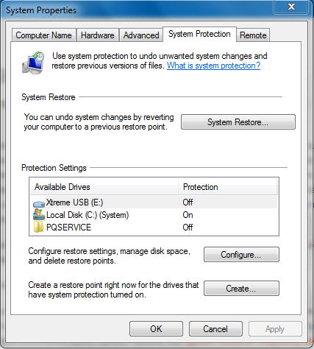
Check System Protection
Open Control Panel.
Navigate to ‘System and Security->System’
In the left hand column click ‘System protection’
Configure Settings

Slide 16
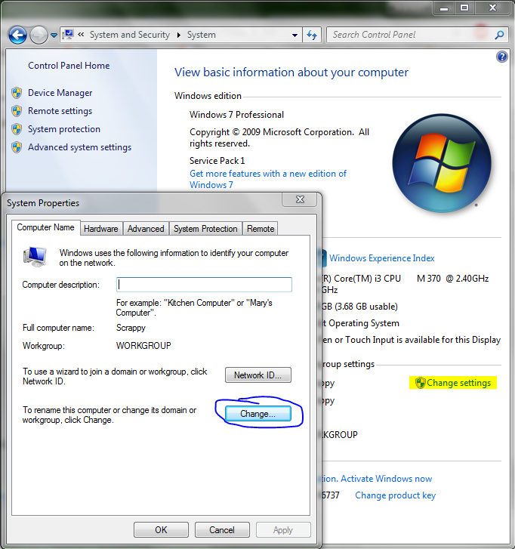
Change Computer Name
Open Control Panel.
Navigate to ‘System and Security->System’
Select ‘Change settings’
Click change and type in new name.

Slide 17
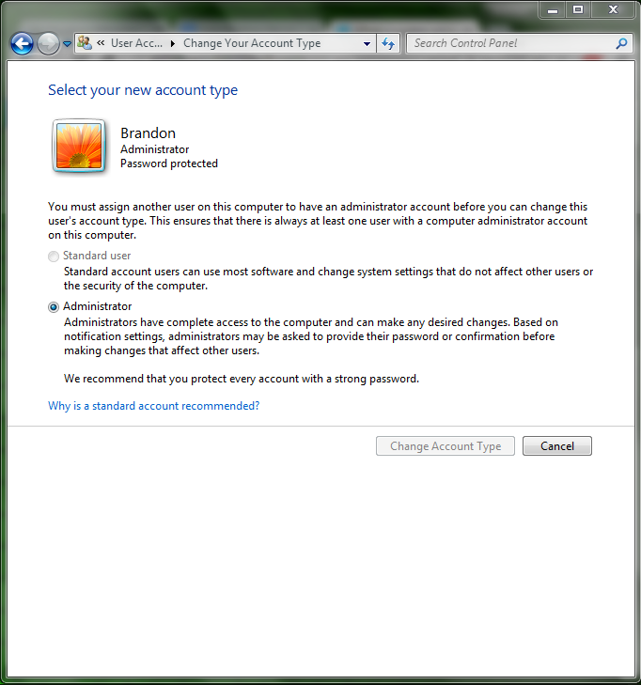
Name the Group
Open Control Panel.
Navigate to ‘User Accounts and Family Safety->User Accounts’
Select ‘Change account type’
.

Slide 18
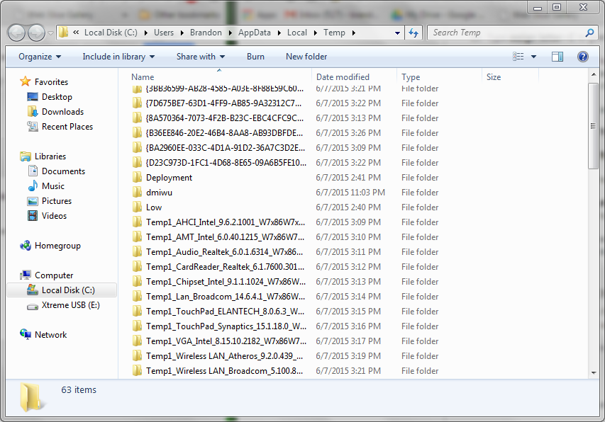
Go to the Temp Folder
Type ‘%temp% in the start menu
.

Slide 19
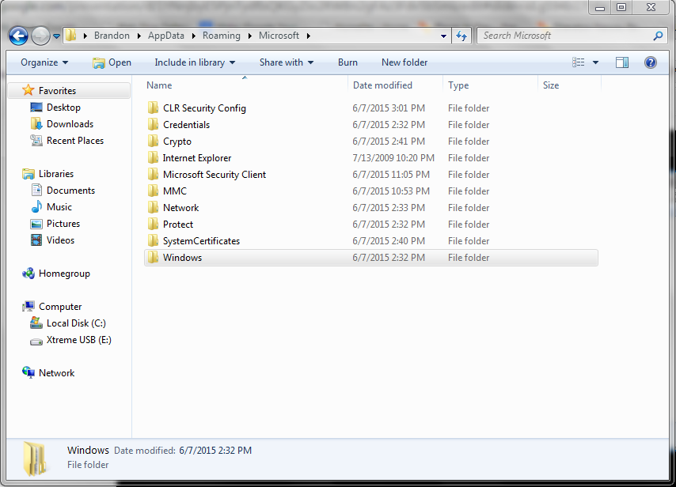
Go to the History Folder
Type ‘%appdata% in the start menu
Navigate to ‘AppData->Local->Microsoft-> Windows->History
.

Slide 20
Go to the Cookies Folder
Type ‘%appdata% in the start menu
Navigate to ‘AppData->Local->Microsoft-> Windows->Cookies
.

Slide 21
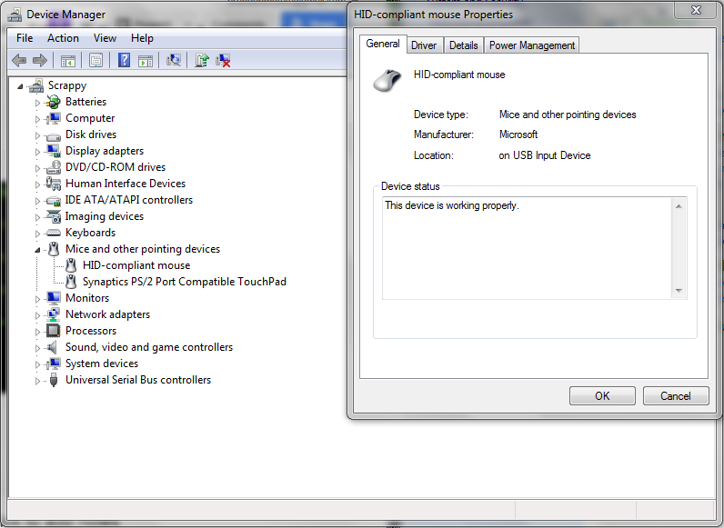
See if all drivers are working properly
Open Control Panel
Navigate to ‘Hardware and Sound’
Click ‘Device Manager’
Double click a device to check it

Slide 22
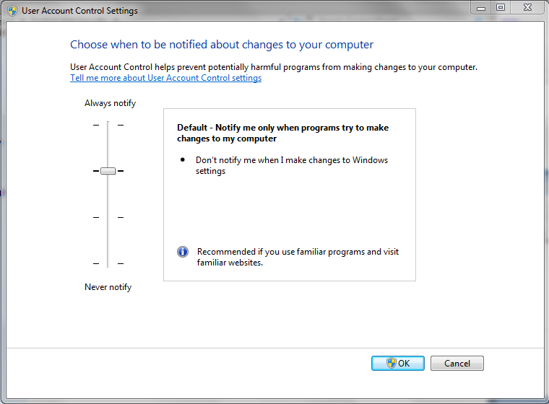
Turning on UAC (User Account Control)
Open Control Panel
Select System and Security
Under ‘Action Center’ select ‘Change User Account Control settings’
Change Setting

Slide 23
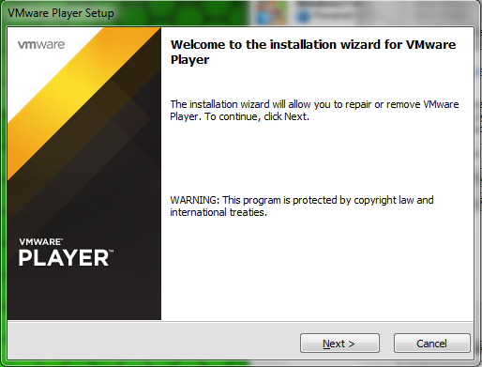
Installing VMware
Open the VMware installer
Click through the option
Select Install location
Finish

Slide 24
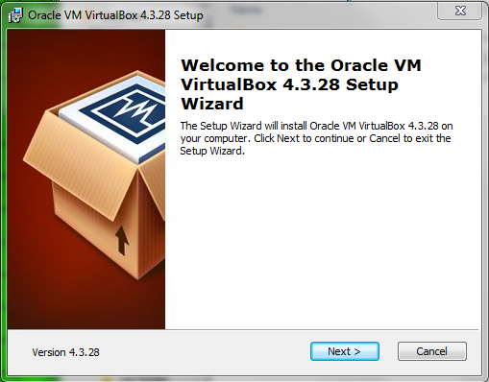
Installing Virtual Box
Open the Virtualbox installer
Open the VMware installer
Click through the option
Select Install location
Finish

Slide 25
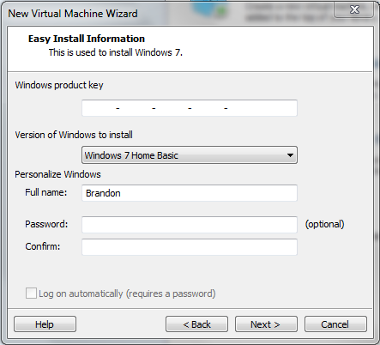
Windows 7 - VMWare
Create New Virtual Machine
Select ‘Installer disc image file (iso)’ then click browse and select the Windows 7 iso.
Select Windows version and fill in ‘Full name’.
Click ‘Next’
A warning for the product key will come up. Click ‘Yes’
Name the VM and select the location for the file
Click ‘Next’ then ‘Finish’

Slide 26
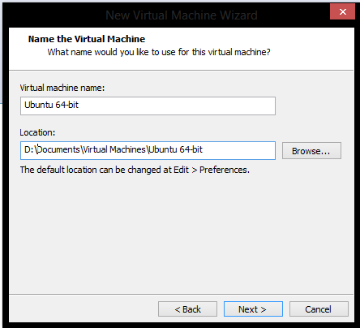
Ubuntu- VMWare
Create New Virtual Machine
Select ‘Installer disc image file (iso)’ then click browse and select the Ubuntu iso.
Personalize Linux.
Click ‘Next’
Name the VM and select the location for the file
Click ‘Next’ then ‘Finish’

Slide 27
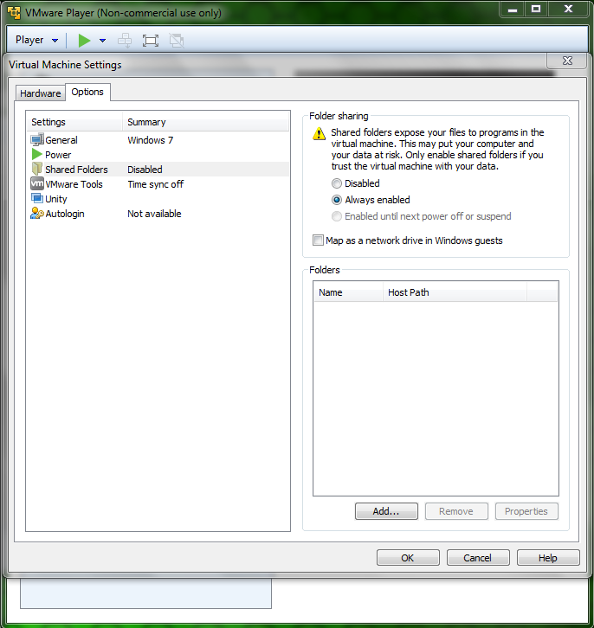
Shared Folder
Navigate to virtual machine settings

Slide 28
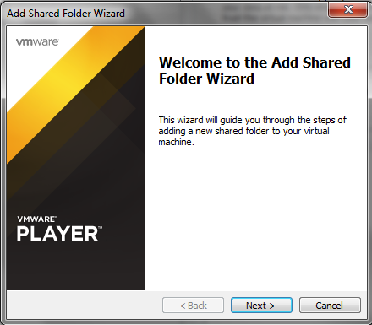
Shared Folder
2. Click your way through the Add Shared Folder Wizard

Slide 29
Shared Folder
Same as with Windows 7

Slide 30
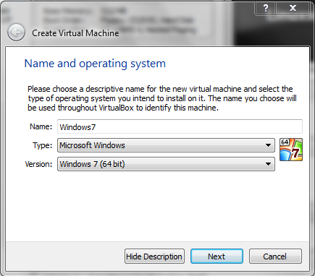
Windows- VirtualBox
Create New Virtual Machine by clicking ‘New’
Name you machine and select os and os version.
Specify Hardware allocations

Slide 31
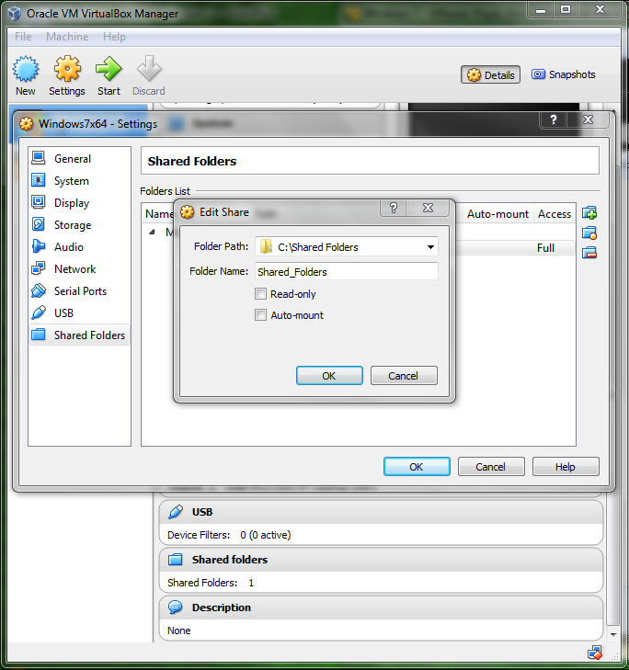
Shared Folder
Navigate to VirtualBox settings, then “shared folders”
Choose your folder path and name

Slide 32
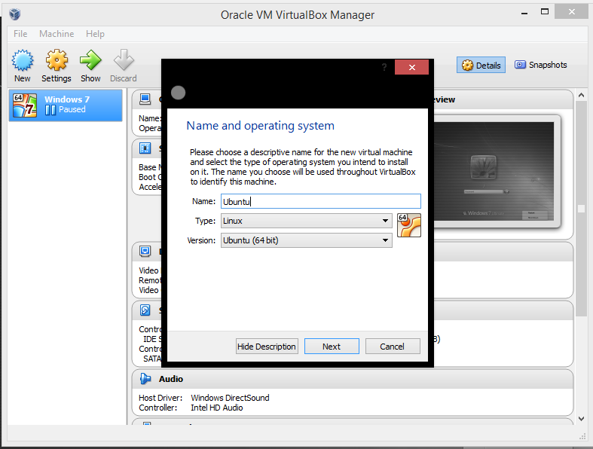
UBUNTU – VirtualBox
Create a new virtual machine
Choose a name
Pick Linux for Type
Pick your version of Ubuntu based on your architecture (x64 or x32)

Slide 33
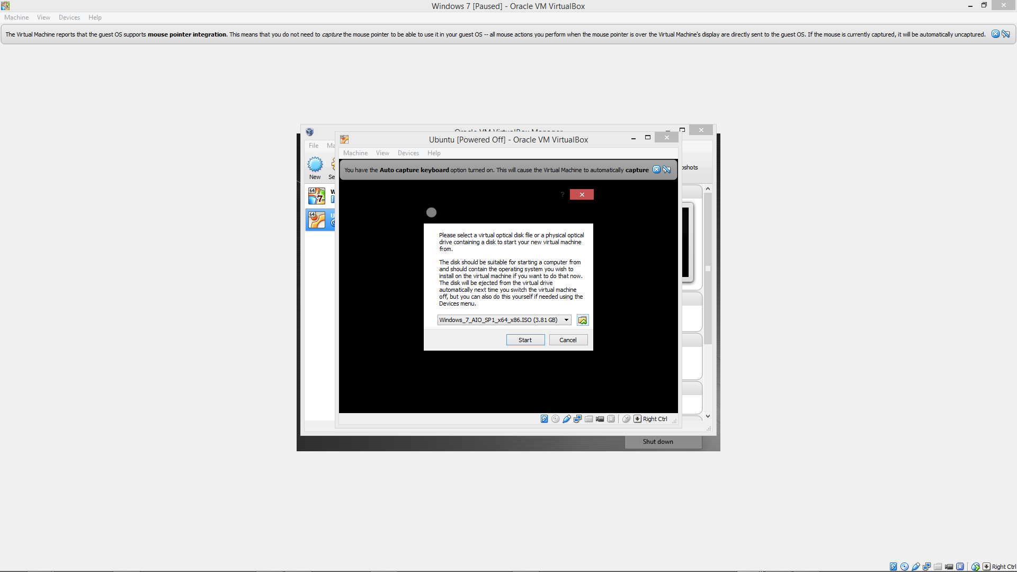
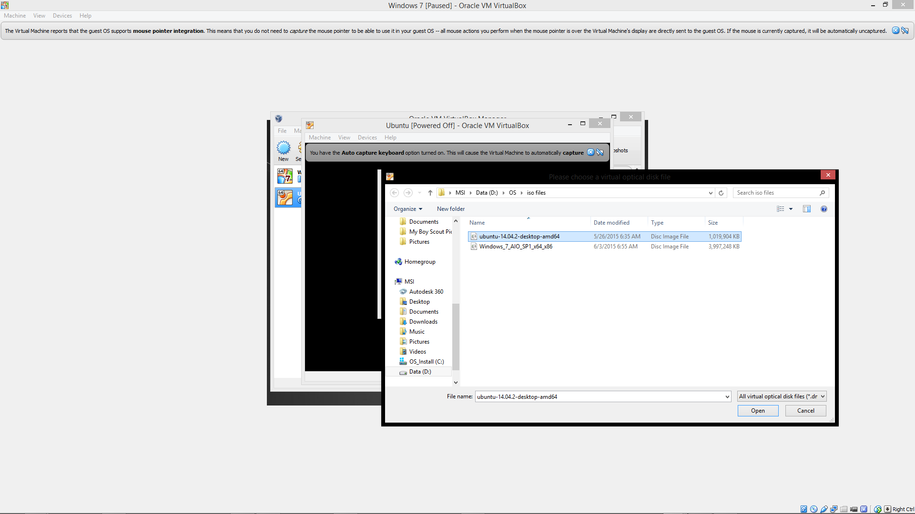
UBUNTU – VirtualBox
Start the new virtual machine
A prompt will appear asking for your .iso file
Choose your Ubuntu iso and your new machine will begin configuring
Fill out your username and password and then you’re done

Slide 34
Shared Folder
Same as with Windows 7

Slide 35
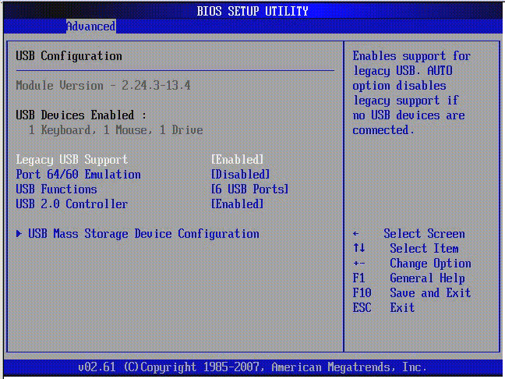
Configure USB Detection in Guest OS
Configure USB detection in the BIOS Setup Utility

Slide 36
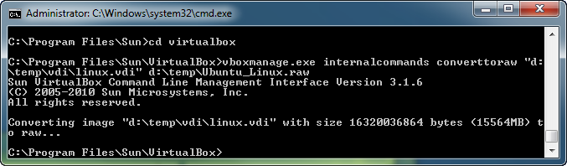
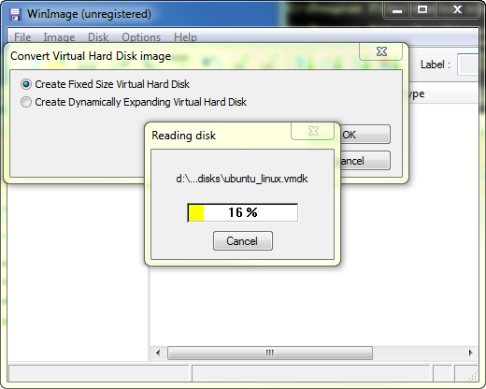
Convert VDI to DMDK Files and vice versa
Go to a cmd prompt and navigate to the VirtualBox folder
Execute this command: vboxmanage.exe internalcommands converttoraw "x\path-to-vdi\diskimage.vdi" "x:\path-to-output-folder\diskimage.raw"
Open WinImage, click ‘Disk’> ‘Convert Virtual Hard Disk Image...’
Next to ‘File name: field, click on the file type drop-down and select ‘All Files’
Navigate to the location where you stored your outputted .raw disk file and double-click it
Choose whether you wish to 'Create Fixed Size Virtual Hard Disk' or 'Create Dynamically Expanding Virtual Hard Disk' (I typically pick the latter) and click 'OK'
Navigate to a folder where you wish to store the newly converted image to. Next to 'Save as type:' (for the sake of this How-to) choose 'VMWare VMDK (*.vmdk). and click 'Save'.
Now that the files are converted, copy or move your converted disk image files to your virtualization software's datastore/disk storage folder.

Slide 37
Add Guest Additions
Use VMWare tools and follow wizard

